Slide 1
FLIGHT PRICE PREDICTION PROJECT PRESENTATION
Submitted by:
SWETA RAI
(Data Science Intern at Flip Robo Technologies)

Slide 2

INTRODUCTION
Business Requirement

Slide 3
PROBLEM STATEMENT
The airline industry is considered as one of the most sophisticated industry in using complex pricing strategies. Nowadays, ticket prices can vary dynamically and significantly for the same flight, even for nearby seats. Anyone who has booked a flight ticket knows how unexpectedly the prices vary. The cheapest available ticket on a given flight gets more and less expensive over time. This usually happens as an attempt to maximize revenue based on
1. Time of purchase patterns (making sure last-minute purchases are expensive)
2. Keeping the flight as full as they want it (raising prices on a flight which is filling up in order to reduce sales and hold back inventory for those expensive last-minute expensive purchases)

Slide 4
PHASES OF THE PROJECT
This project is done in three parts:
- Data Collection
- Data Analysis
- Model Building
I created two different Jupyter Notebook files to performed the required actions.
As per the requirement of client, I have scrapped the data from online sites and based on that data I have performed analysis like based on which feature of my data does flight prices change and checked the relationship of flight prices with all the other features to get a gist on what flight a passenger should choose.

Slide 5
JUPYTER NOTEBOOK USAGE
Used the Python programming in Jupyter Notebook for 2 separate files
In the first notebook I wrote down the code to extract data for Flight prices and details from various web pages and stored them in a comma separated value file
Then the second notebook was created to make a Flight Price Prediction project and analyze various ways to get better predicted results
Web Scraping
Wrote code to collect data
Ensured the data collected is legitimate and valid
Machine Learning
Performed Data cleaning, EDA, Visualization etc.
Created multiple models and hyper tuned them

Slide 6

MODEL BUILDING STEPS
1. Data Cleaning
2. Exploratory Data Analysis
3. Data Pre-processing
4. Model Building
5. Model Evaluation
6. Selecting the best model

Slide 7
DATA SCIENCE LIFE CYCLE
Data Cleaning
Import the collected data from web scraping
Exploratory Data Analysis
Check through all the dataset information like datatype, missing value, duplicate value etc.
Visualization and Data Preprocessing
Use various visualization methods to check the data distribution identify presence of outliers and skewness
Clean and format the records as per usage by using various imputation techniques
Analyze each and every data record to ensure we have usable information
Perform encoding and scaling methods

Slide 8
DATA SCIENCE LIFE CYCLE
Model Building
Create appropriate Regression Machine Learning model function
Model Evaluation
Usage of evaluation metrics to check the accuracy of the models over trained and test data inputs
Hyperparameter Tuning Best Model
Choosing the appropriate Regression Machine Learning model to check various parameter permutation and combinations
Need to ensure that whenever the regression function is called it is able to process all the necessary parameters
Ensure the cross validation techniques helps in reducing over fitting and under fitting data
Using Grid Search CV to obtain the best parameters that can be plugged into the selected model

Slide 9
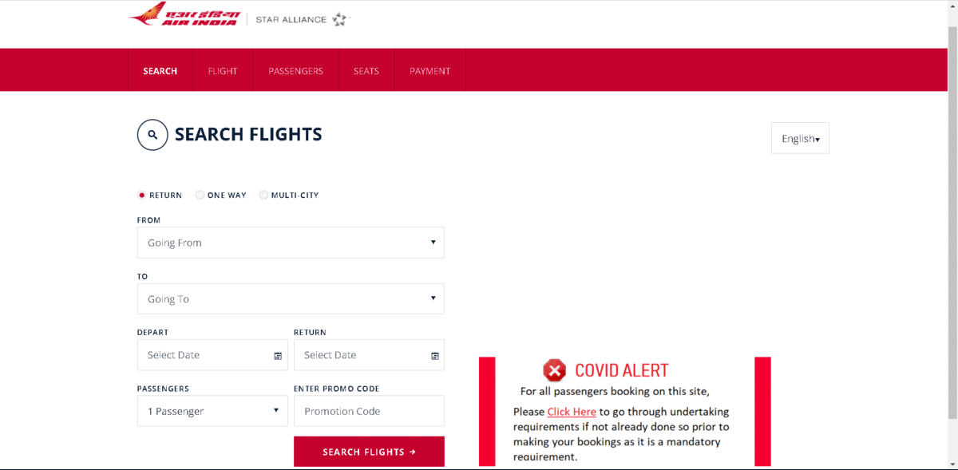
WEB SCRAPING WEBPAGES FOR FLIGHTS

Slide 10
DATA PREPROCESSING
Importing the necessary dependencies and libraries.
Reading the CSV file and converted into data frame.
Checking the data dimensions for the original dataset.
Looking for null values and accordingly renaming the values.
Checking the summary of the dataset.
Checking unique values.
Checking all the categorical columns in the dataset.
Ensuring that the values are good to use and discarding junk data.

Slide 11
DATA PREPROCESSING
Visualizing with the use of pandas profiling feature.
Visualizing each features using matplotlib and seaborn.
Performing encoding using the ordinal encoder on categorical features.
Checking for co-relation/multi-collinearity in a heatmap.
Checking for Outliers/Skewness using boxen plot and distribution plot.
Checking for the final dimension of dataset to confirm the input details.
Creating train test split and the best random state found in the range 1-1000.
Taking a look at the importance of feature details to analyse further.

Slide 12
TECHNOLOGY USED
Hardware technology being used.
RAM : 8 GB
CPU : AMD Ryzen 5 3550H with Radeon Vega Mobile Gfx 2.10 GHz
GPU : AMD Radeon ™ Vega 8 Graphics and NVIDIA GeForce GTX 1650 Ti
Software technology being used.
Programming language : Python
Distribution : Anaconda Navigator
Browser based language shell : Jupyter Notebook
Libraries/Packages specifically being used.
Pandas, NumPy, matplotlib, seaborn, scikit-learn, pandas-profiling, missingno

Slide 13
EXPLORATORY DATA ANALYSIS (EDA) AND VISUALIZATION
01. Univariate Analysis
02. Multivariate Analysis
03. Correlation of Dataset
Univariate analysis is the simplest form of analyzing data. “Uni” means “one”, so in other words your data has only one variable.
Multivariate analysis is a set of statistical techniques used for analysis of data that contain more than one variable.
Correlation is used to test relationships between quantitative variables or categorical variables.
04. Correlation with Target variable
05. Conclusion
Correlation with the target variable to know how the data is related.
Summary with the conclusion of all the analysis

Slide 14
EXPLORATORY DATA ANALYSIS (EDA)
First I have imported the necessary libraries and loaded the entire dataset in our Jupyter Notebook and renamed the project file from untitled.
Then I checked the shape of our dataset and found that we have a total of 5,805 rows and 9 different columns.
We don’t have any null values or missing values present in our dataset from the web scraping.
There were 232 duplicate rows/records in our dataset but I decided to retain them instead of deleting it.
By checking the data types I came to know that our data set consists of columns having only object datatype even those there were numeric information present.
Shape : 5,805 rows and 9 columns
No null values present
232 duplicate rows/records were found
Datatype of only object columns are in dataset

Slide 15
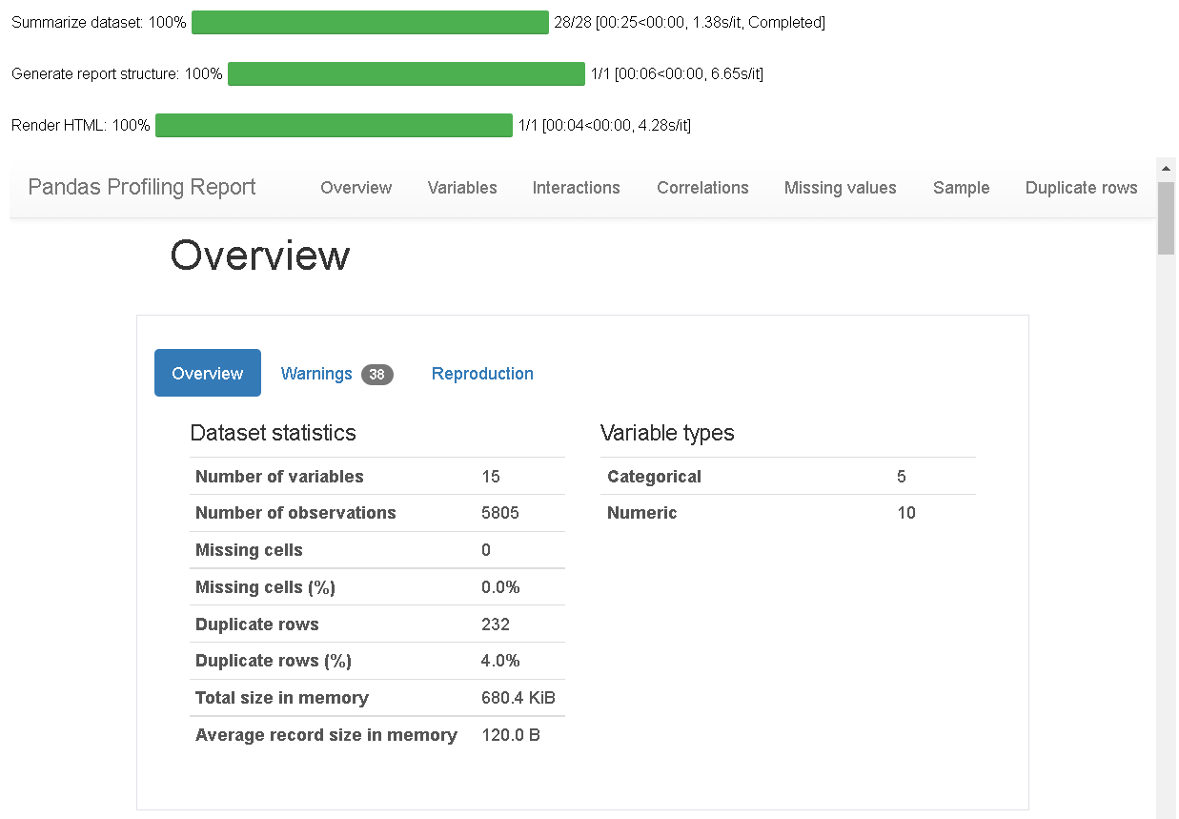
VISUALIZATION USING PANDAS PROFILING REPORT
Here I have made use of pandas profiling to get a gist of my pre processed data and get a insight on the basic overview of my dataset values.

Slide 16
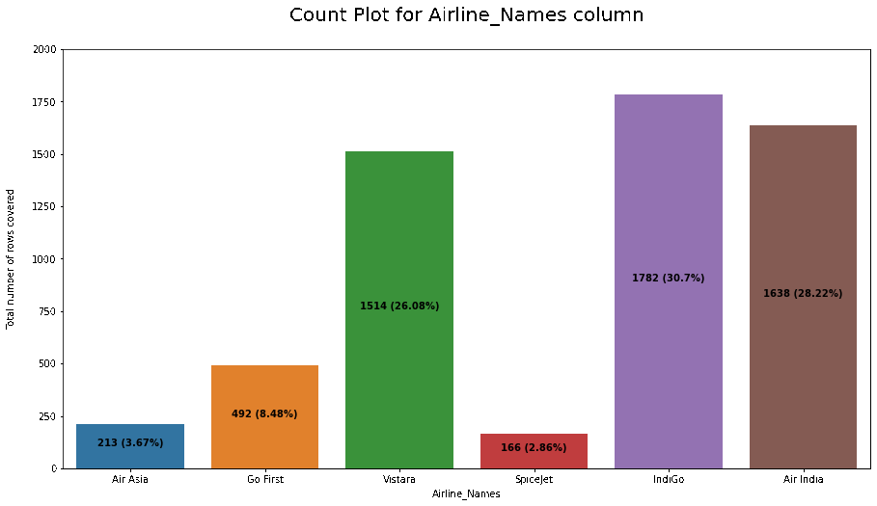
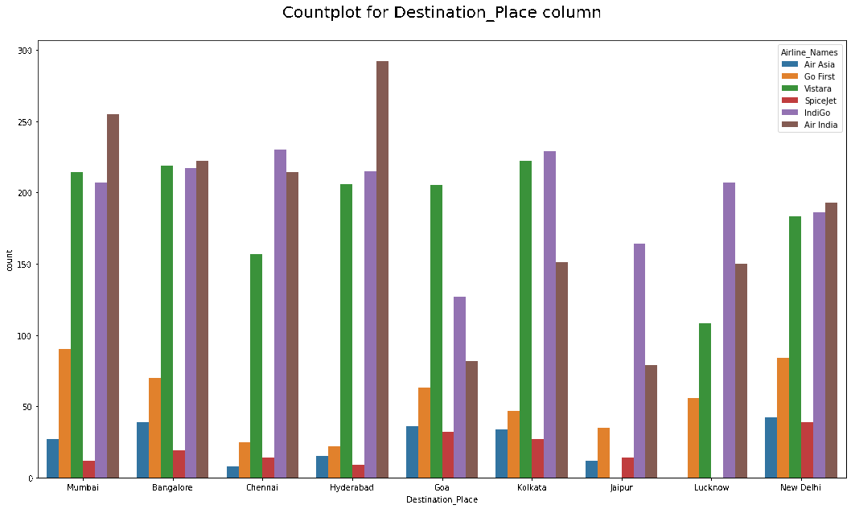
COUNT PLOTS

Slide 17
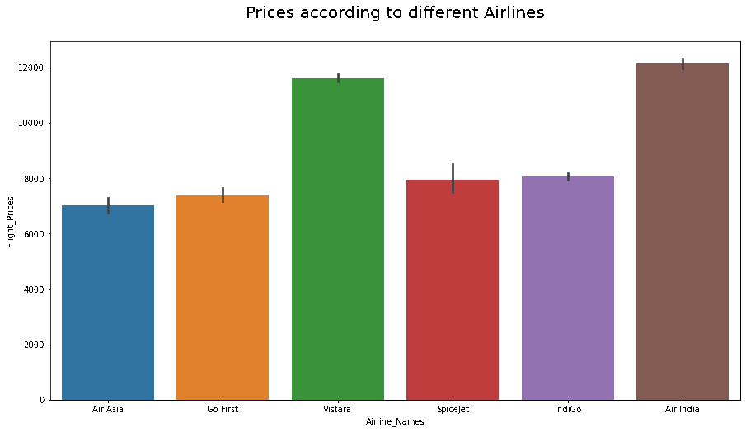
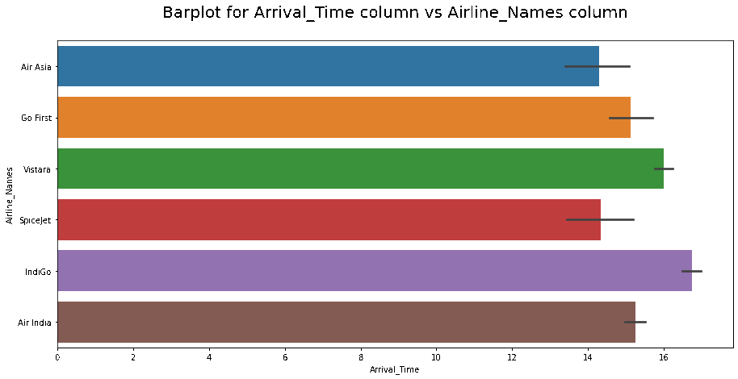
BAR PLOTS

Slide 18
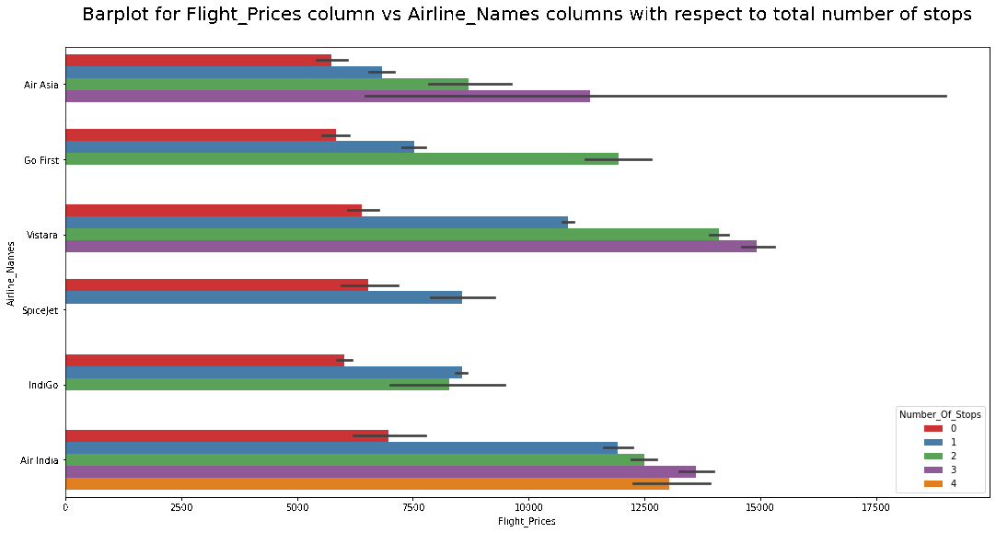
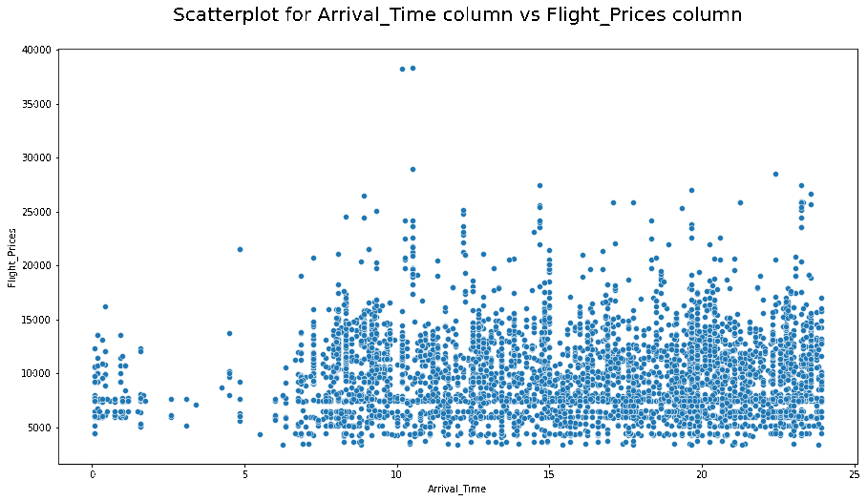
BAR PLOTS AND SCATTER PLOTS

Slide 19
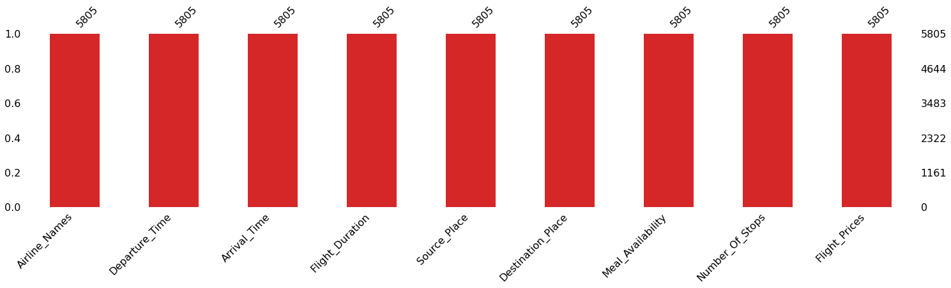
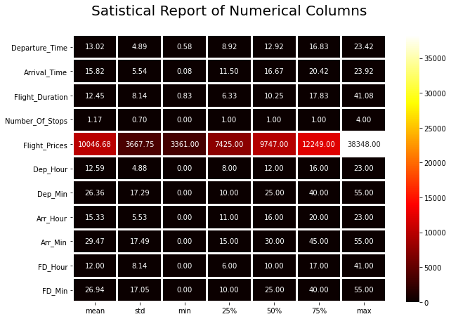
MISSING VALUES AND DESCRIBE DATA

Slide 20
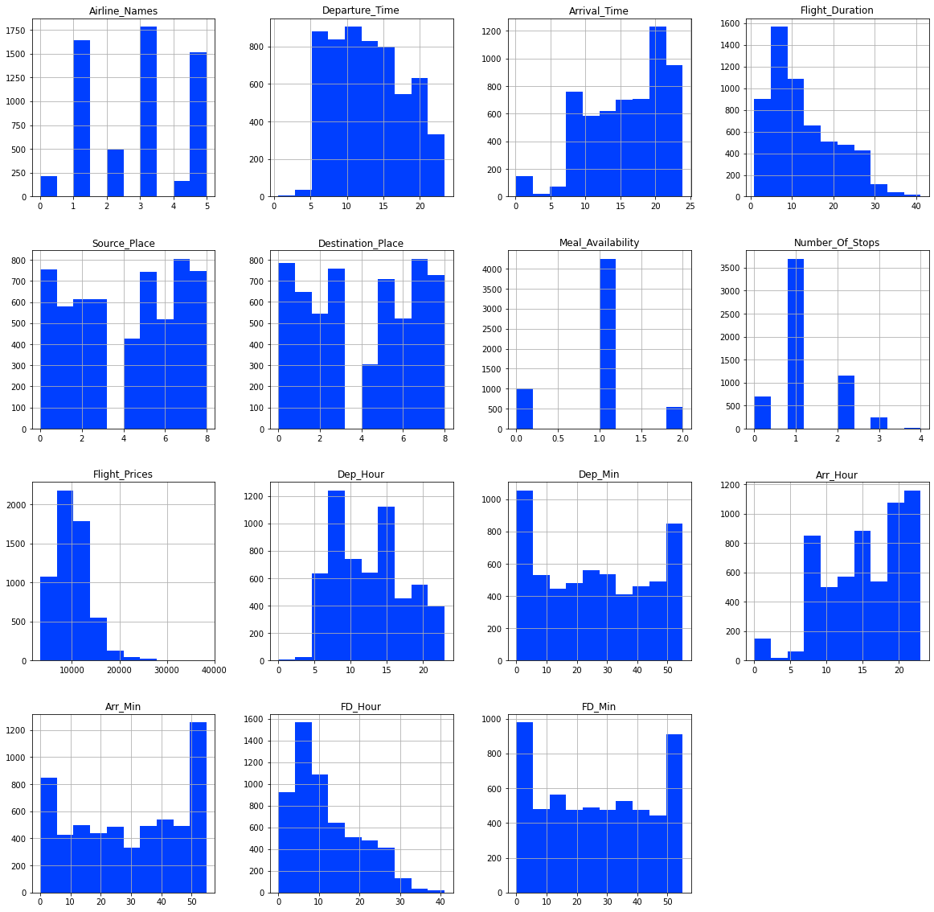
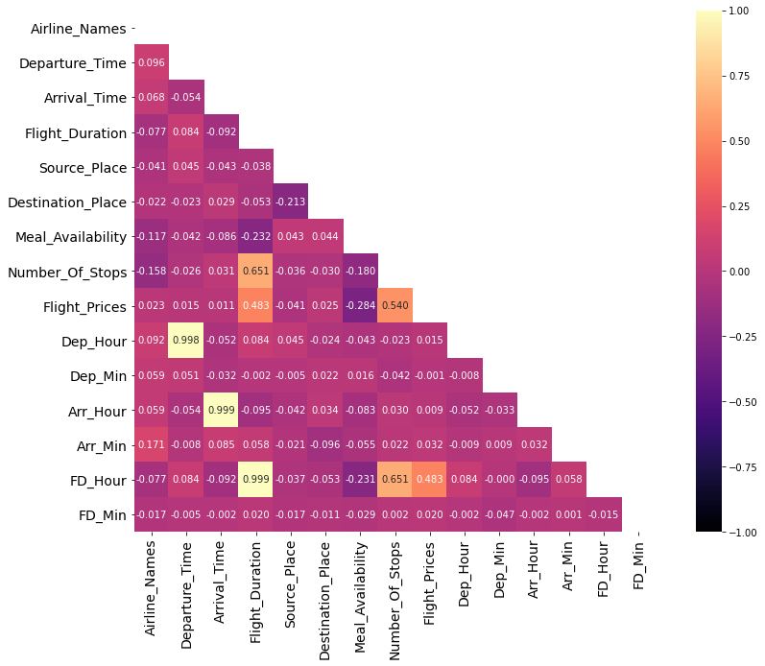
HISTOGRAM AND HEATMAP

Slide 21
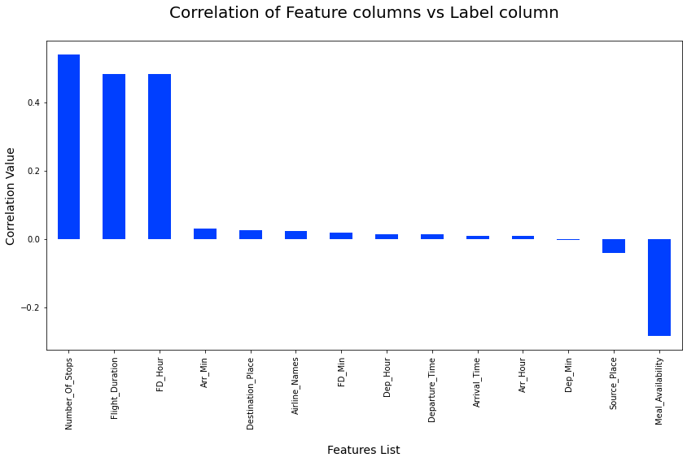
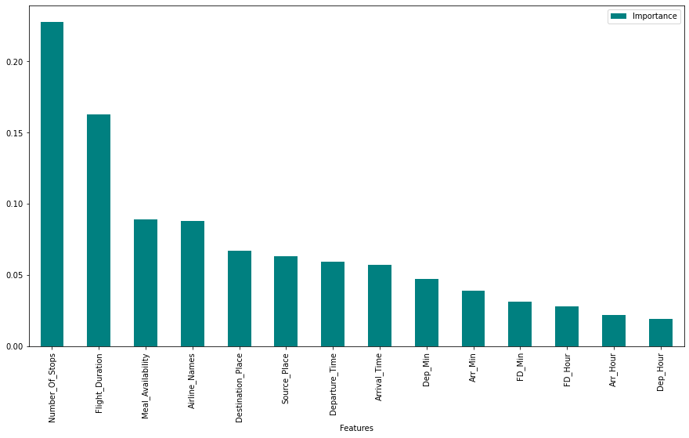
CORRELATION AND IMPORTANCE BAR GRAPHS

Slide 22
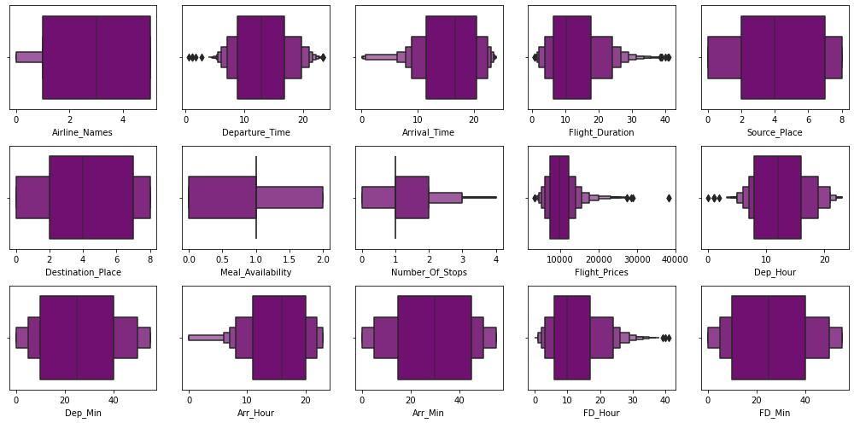
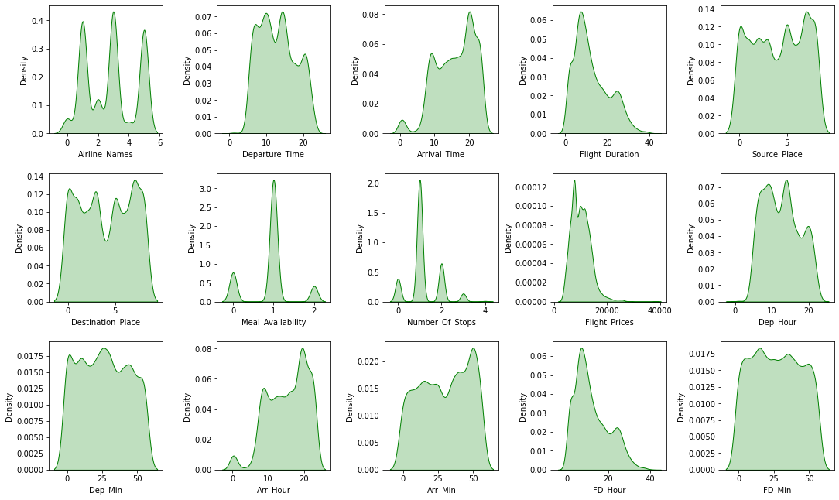
OUTLIERS AND SKEWNESS

Slide 23
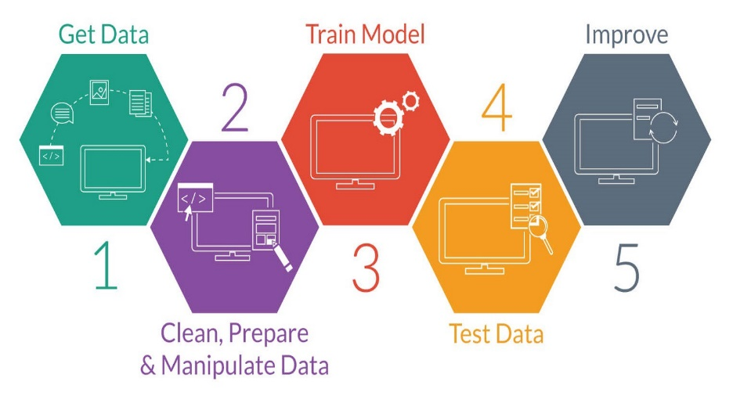
MODEL TRAINING PHASES

Slide 24

REGRESSION MACHINE LEARNING MODEL/S USED
▪ Linear Regression Model
▪ Ridge Regularization Model
▪ Lasso Regularization Model
▪ Support Vector Regression Model
▪ Decision Tree Regression Model
▪ Random Forest Regression Model
▪ K Neighbours Regression Model
▪ Gradient Boosting Regression Model
▪ Ada Boost Regression Model
▪ Extra Trees Regression Model

Slide 25
REGRESSION MODEL FUNCTION WITH EVALUATION METRICS

Slide 26
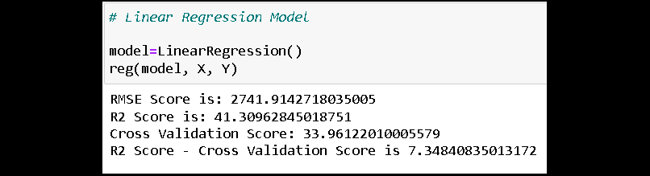
RESULT OF MULTIPLE REGRESSION MODELS

Slide 27
EVALUATION AND HYPER PARAMETER TUNING
The key metrics used here were:
R2 score
Cross Validation Score
MAE
MSE
RMSE
We tried to find out the best parameters list to increase our accuracy scores by using Hyperparameter Tuning. In order to achieve a higher score we used the Grid Search CV method with 5 folds.

Slide 28

Inference
Concluding the project outcome

Slide 29
KEY FINDINGS AND CONCLUSIONS OF THE STUDY
In this project we have scraped the flight data from airline webpages. Features like flight duration, number of stops during the journey and the availability of meals are playing major role in predicting the prices of the flights.
It could also help customers to predict future flight prices and plan the journey accordingly because it is difficult for airlines to maintain prices since it changes dynamically due to different conditions. Hence by using Machine Learning techniques we can solve this problem.
The above research will help our client to study the latest flight price market and with the help of the model built he can easily predict the price ranges of the flight, and also will helps him to understand Based on what factors the fight price is decided.

Slide 30
LEARNING OUTCOMES OF THE STUDY IN RESPECT OF DATA SCIENCE
Visualization part helped me to understand the data as it provides graphical representation of huge data.
It assisted me to understand the feature importance, outliers or skewness detection and to compare the independent-dependent features.
Data cleaning is the most important part of model building and therefore before model building, I made sure the data is cleaned.
I have generated multiple regression machine learning models to get the best model wherein I found Extra Trees Regressor Model being the best based on the metrics I have used.
Ensured that I at least get a decent prediction confidence percentage.

Slide 31
LIMITATIONS OF THIS WORK AND SCOPE FOR FUTURE WORK
Some algorithms are facing over-fitting problem which may be because of a smaller number of features in our dataset.
Limitation of the study is that in the volatile changing market we have taken the data, to be more precise we have taken the data at the time of pandemic and recent data, so when the pandemic ends the market correction might happen slowly.
Therefore based on that again the deciding factors of it may change and we have shortlisted and taken these data from the important cities across India.
If the customer is from the different country our model might fail to predict the accuracy prize of that flight.

Slide 32
